Slide 1




PARTICIPANT PRESENTATION
Participant Details
Qiskit
Fall Fest
2026
Q-Lithos
Hybrid Quantum- Classical simulation for Battery material screening
TRACK 8 – Quantum Chemistry and sensing
TEAM NAME
Anonymous
TEAM LEADER
Nandita salunke
EMAIL / CONTACT
nanditasalunke00@gmail.com
Hackathon · Team Details
TEAM MEMBERS
Ramling belkeri
Visvesvaraya Technological university , Belagavi
COUNTRY
India

Slide 2
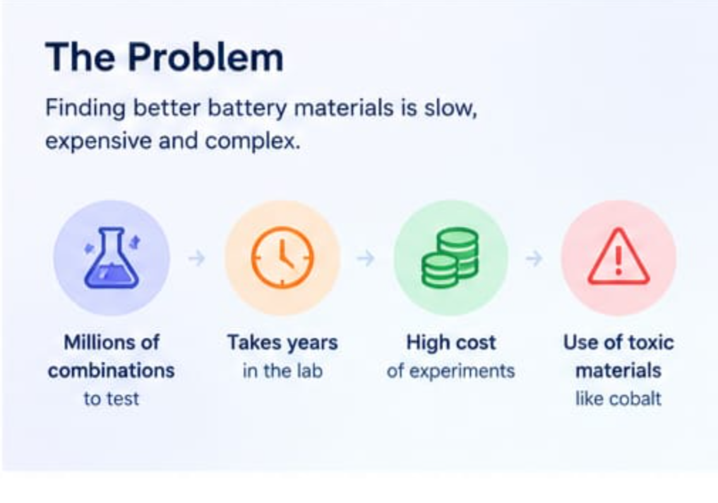
Problem Statement
Why Battery Material Discovery is slow
Battery performance depends on complex atomic interactions at electrode and solid-electrolyte interfaces. These interactions can involve strong electron correlation, which is difficult to model accurately.
Classical methods are useful for screening, but some approximations may miss important electronic behaviour. Testing every candidate physically is costly and time-consuming.

Slide 3
Objectives & Novelty
OUR NOVELTY
One Interactive Platform Combines molecular exploration, quantum-classical energy comparison, and visual analysis in one dashboard.
Transparent Results Shows calculation errors and explains limitations, helping users understand
what the results mean for battery-related research.
EXPLORE
Study how molecular energy changes as the distance between atoms varies in molecules.
COMPARE
Compare VQE-calculated energies with classical exact-diagonalization results for the same molecular model and bond distance.
VISUALISE
Present interactive energy curves, calculation errors, and molecular properties through an easy-to-use Streamlit dashboard.

Slide 4
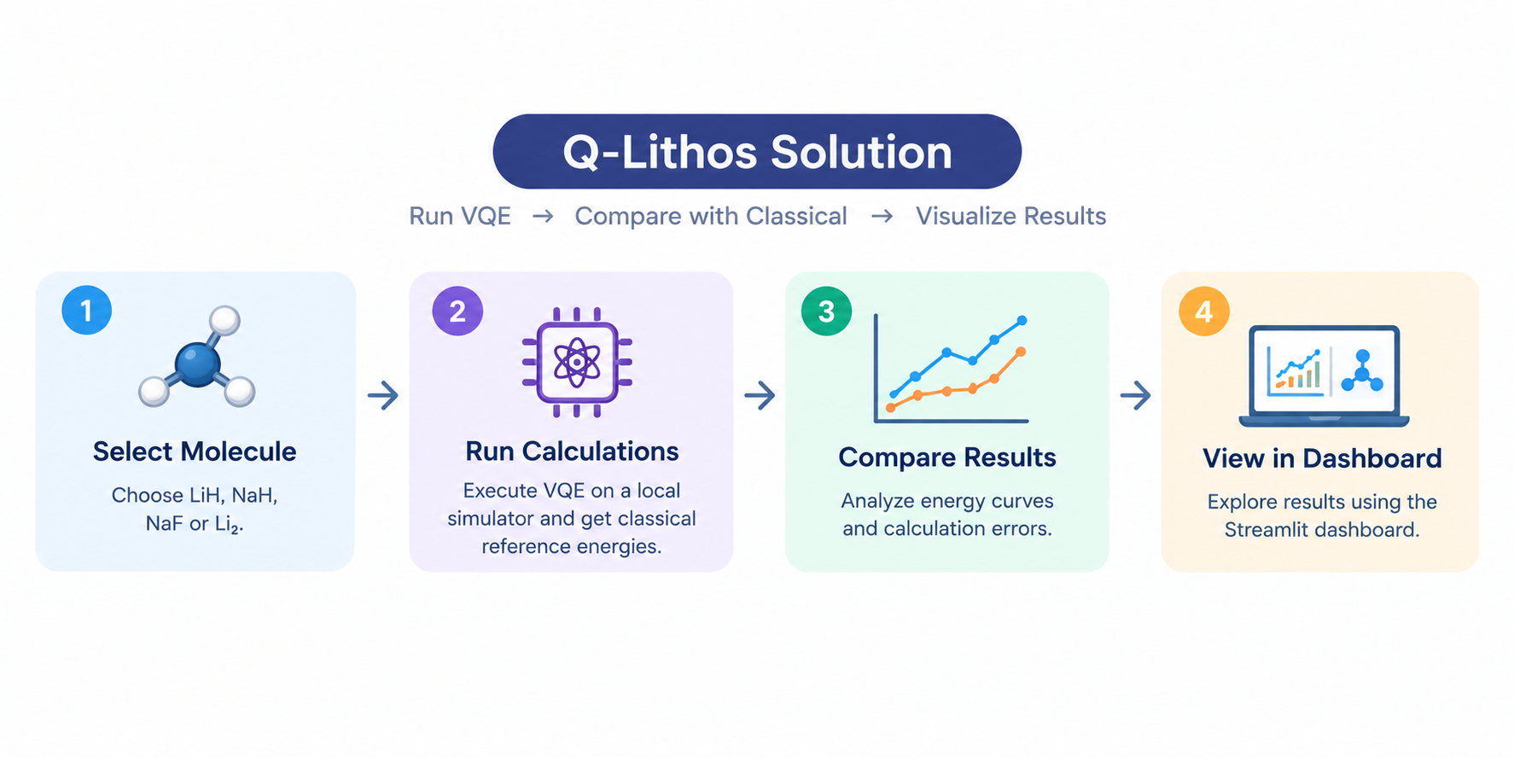
Solution & Quantum Advantage
SOLUTION — Q-LITHOS
Q-Lithos uses Qiskit’s VQE to calculate molecular energies, compare them with classical results, and display the findings in an interactive dashboard.
HOW IT WORKS
Step Description
1. Select Choose a molecule for example, LiH, NaH, NaF, or Li₂.
2. Calculate Run VQE on a local simulator and obtain classical reference energies.
3. Compare Analyze energy curves and calculation errors.
4. Visualize Explore results using the Streamlit dashboard

Slide 5
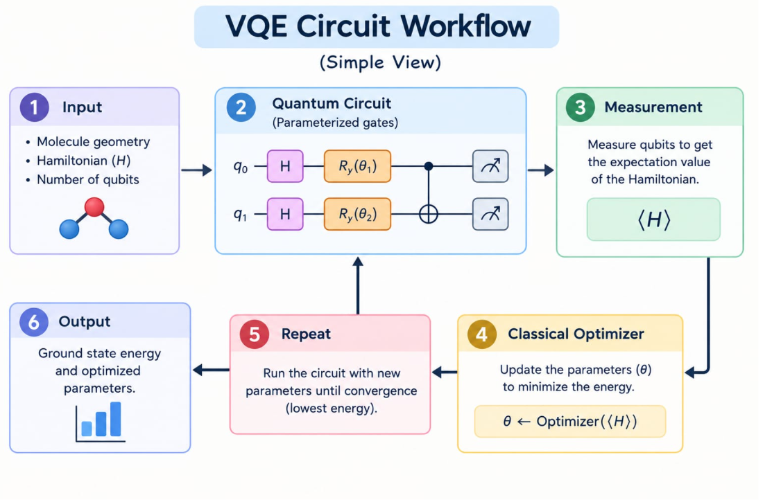
Algorithm & Circuit Design
Component Method
Ansatz UCCSD
Optimizer SLSQP
Simulator Local ideal state vector
Reference Classical exact diagonalization
Insert circuit diagram
e.g. qc.draw("mpl")

Slide 6
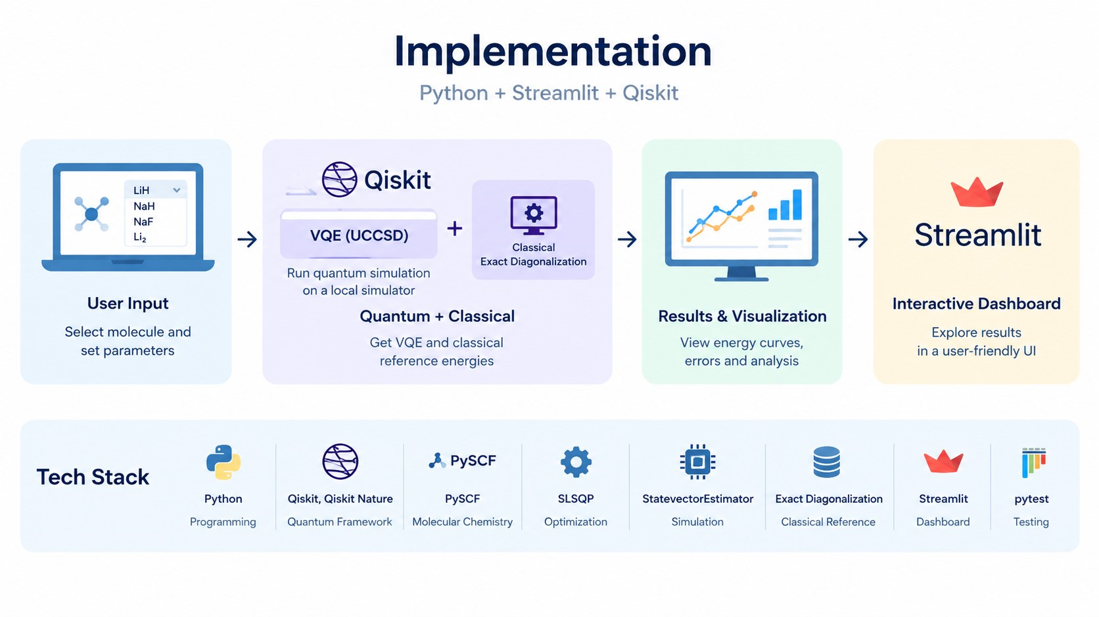
Implementation & Tech Stack
IMPLEMENTATION
Q-Lithos is built in Python with a Streamlit dashboard. It combines Qiskit-based VQE simulations, classical energy comparisons, and interactive visualizations.
TECH STACK
Component Technology / Purpose
Programming Python
Quantum Framework Qiskit, Qiskit Nature
Molecular Chemistry PySCF, where supported
Quantum Algorithm VQE with UCCSD
Optimization SLSQP
Simulation Local StatevectorEstimator
Classical Reference Exact diagonalization
Dashboard Streamlit
Testing pytest

Slide 7
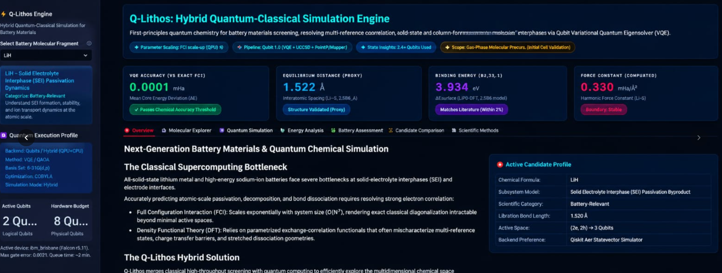
Results & Analysis
Insert results
Histogram, plot or table
RESULTS & ANALYSIS
Q-Lithos compares molecular energies calculated using VQE with classical exact-diagonalization results. The dashboard visualizes energy changes across bond distances and helps examine calculation errors.

Slide 8
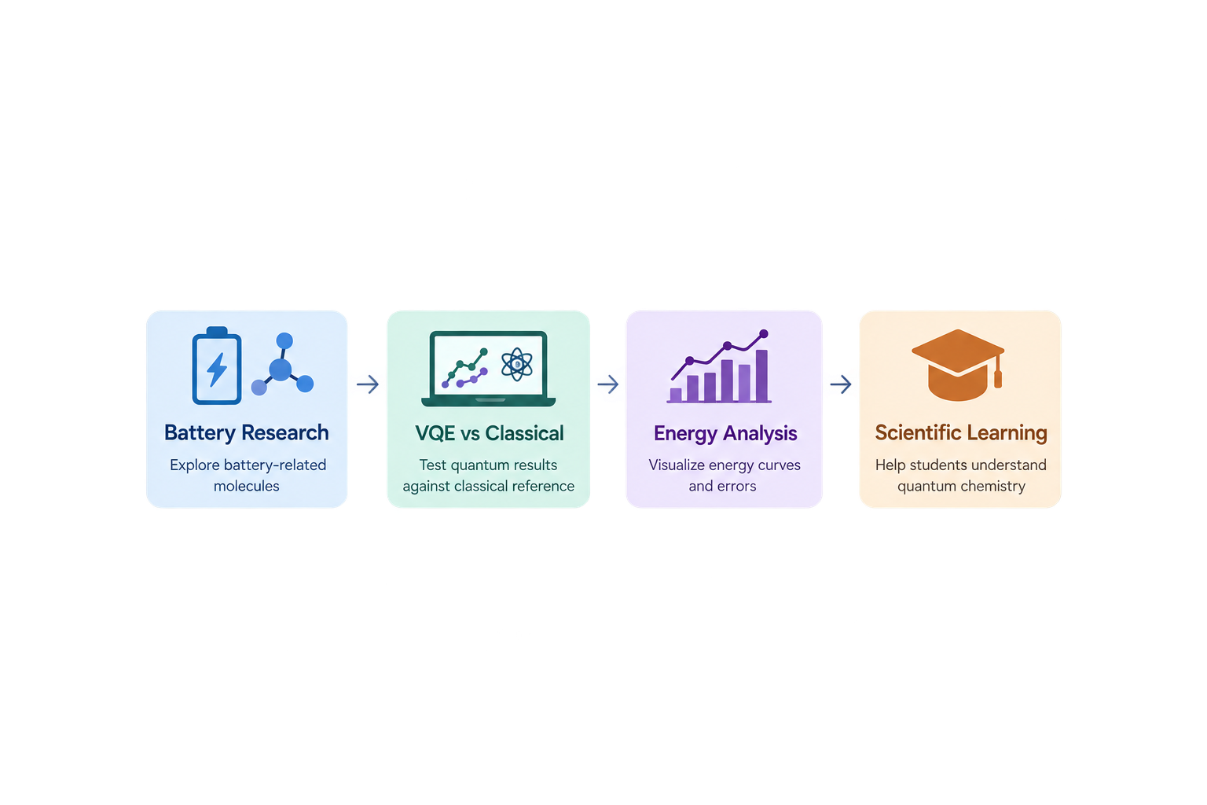
Impact & Real-World Applications
REAL-WORLD IMPACT
Q-Lithos makes quantum-chemistry calculations easier to explore and understand. By comparing VQE results with classical calculations, it helps users study molecular energy changes and evaluate the accuracy of quantum-algorithm results.
APPLICATIONS & POTENTIAL IMPACT
Application Potential Impact
Battery Chemistry Research Explore the energy behaviour of selected battery-related molecules.
Quantum Algorithm Testing Evaluate VQE results against classical reference calculations.
Scientific Learning Help students understand molecular energy curves and quantum chemistry.
Early-Stage Exploration Visualize results and identify questions for further research.
OUR IMPACT
Explore molecules. Compare calculations. Understand limitations.

Slide 9
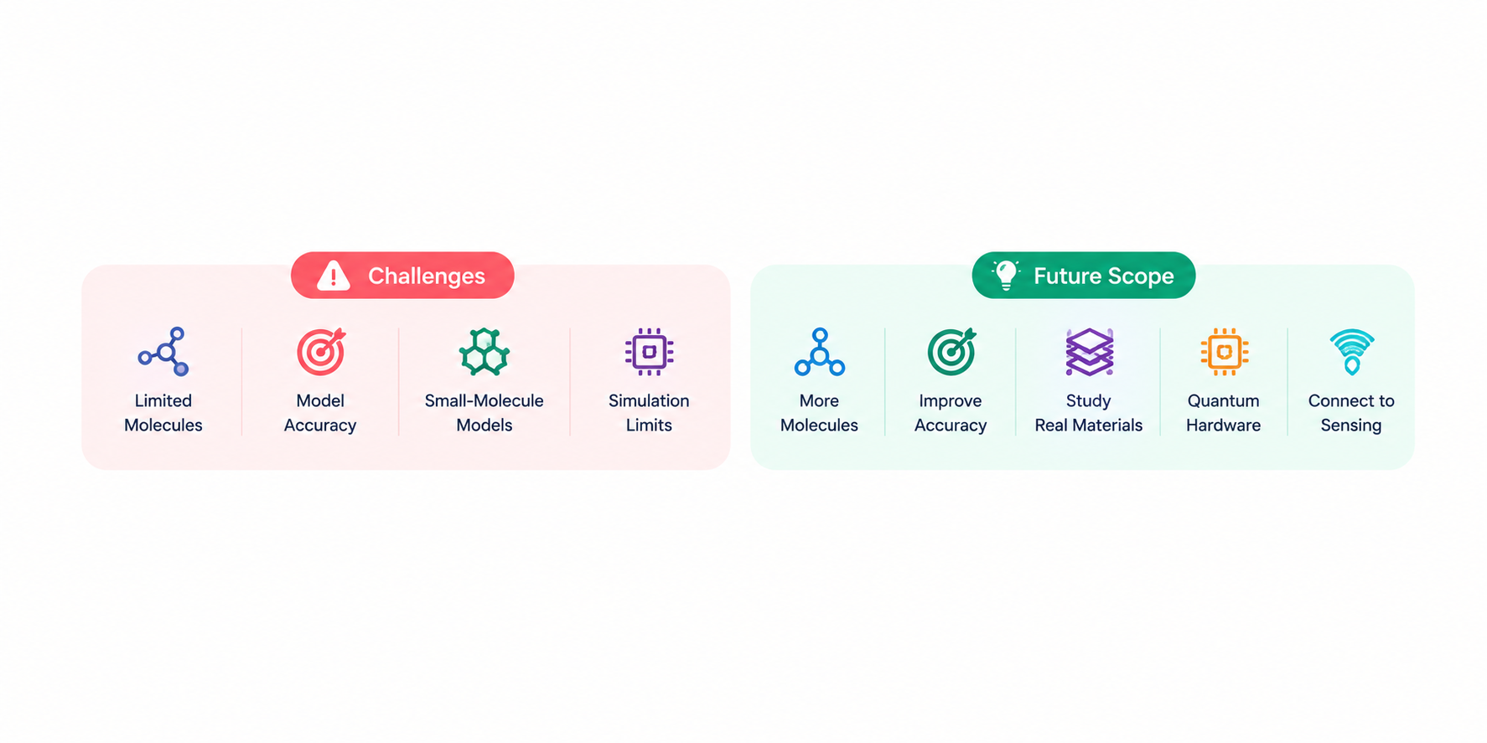
Challenges & Future Scope
CURRENT CHALLENGES
Challenge What it means
Limited Molecules Currently explores LiH, NaH, NaF, and Li₂.
Model Accuracy Results depend on the chosen basis set and active space.
Small-Molecule Models Current calculations do not represent complete battery materials.
Simulation Limits Uses an ideal local simulator, not physical quantum hardware.
FUTURE SCOPE
Planned Improvement Our Direction
Add More Molecules Introduce more battery-relevant molecules selected for scientific value and computational feasibility.
Improve Accuracy Test larger basis sets and validate energy calculations and cached results.
Study Real Materials Progress towards modelling interfaces, ion movement, and material properties using suitable methods.
Explore Quantum Hardware Investigate hardware execution and noise-aware simulations when feasible.
Connect to Sensing Explore a suitable chemistry-related sensing application as a future extension.

Slide 10
CLOSING
Thank You
Questions?
Inspiring Minds. Shaping Tomorrow.
GITHUB REPO
https://github.com/vtu-qiskit-fall-fest-2026/vtu-hc-anonymous
DEMO VIDEO LINK
https://youtu.be/ediQHrTX8oo

